Slide 1

Calculating Churn Rates Analyze Real Data with SQL Phoebe Namyalo March 2022

Slide 2
Table of Contents
Get familiar with the company.
How many months has the company been operating?
Which months do you have enough information to calculate a churn rate?
What segments of users exist?
What is the overall churn trend since the company started?
Compare the churn rates between user segments.
Which segment of users should the company focus on expanding?

Slide 3
1. Introduction

Slide 4
1.1 Introduction
Churn rate
Churn rate is the percent of subscribers that have canceled within a certain period, usually a month. For a user base to grow, the churn rate must be less than the new subscriber rate for the same period.
Codeflix’s marketing department is particularly interested in how the churn compares between two segments of users. They provide you with a dataset containing subscription data for users who were acquired through two distinct channels 87 and 30
The dataset provided to you contains one SQL table subscriptions. Within the table, there are 4 columns:
id - the subscription id
subscription_start - the start date of the subscription
subscription_end - the end date of the subscription
segment - this identifies which segment the subscription owner belongs to.

Slide 5
1.2 Overview of Codeflix Dataset
Company
Codeflix, a streaming video startup running 2 ad campaigns for segments 87 and 30. It is interested in measuring the churn rate between the two segments of users.
Dataset
Codeflix requires a minimum of 31 days subscription to consider a user active. So if a user started on 2016-12-1, can only cancel after 31 days.
Months for Churn rate Calculation
Based on the data minimum subscriptions started on 2016-12-01 and since a user can never start and end their subscription in the same month, we can only calculate churn rate in the month of January, February and March.
SELECT
FROM subscriptions
LIMIT 100;
-- Identfy months for churn rate
SELECT MIN( subscription_start),
MAX(subscription_start)
FROM subscriptions;
MIN( subscription_start) | MAX(subscription_start)
2016-12-01 | 2017-03-31

Slide 6
2. Churn Rate

Slide 7
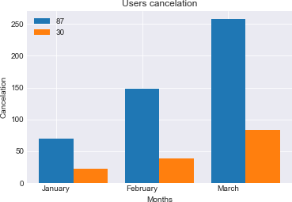
2. 1 Number of Active and Cancelled Users per Segment
month | sum_active_87 | sum_active_30 | sum_canceled_87 | sum_canceled_30
2017-01-01 | 278 | 291 | 70 | 22
2017-02-01 | 462 | 518 | 148 | 38
2017-03-01 | 531 | 716 | 258 | 84
This provides a list of months, with their corresponding number of active users at the beginning of the month and the number of those users who cancel during the month per segment

Slide 8
3. Churn rates between user segments

Slide 9
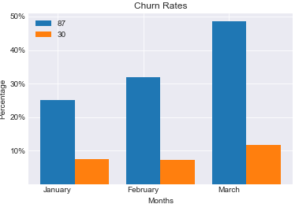
3. 1 Churn rate for each Segment per Month
We use the number of canceled and active subscriptions to calculate churn for each month per segment: January segment 87: 25% & segment 30 : 8% February segment 87: 32% & segment 30 : 7% March segment 87: 49% & segment 30 : 12% The related query is attached under Appendix 1.
month | churn_rate_87 | churn_rate_30
2017-01-01 | 0.251798561151079 | 0.0756013745704467
2017-02-01 | 0.32034632034632 | 0.0733590733590734
2017-03-01 | 0.485875706214689 | 0.11731843575419

Slide 10
3.2 Conclusion
From the results, segment 30 is performing better and has a lower churn rate which means less people are unsubscribing so the company should focus more on this and expand it.
Segment 87 is not performing well due to the higher churn rate. This could be a number of reasons like the marketing language was not descriptive enough or the design was not captivating enough . The company should look into it and compare what segment 30 is doing different from segment 87.
Get feedback from customers through email marketing, reviews, incentives and generate an analysis on the ad to figure out why it is failing.

Slide 11
4. Appendix : SQL code

Slide 12
Appendix 1
CASE
WHEN (subscription_start < first_day)
AND (subscription_end > first_day
OR subscription_end IS NULL)
AND (segment = 30)
THEN 1
ELSE 0
END AS is_active_30,
-- User Cancellation status for each segment
CASE
WHEN subscription_end BETWEEN first_day AND last_day
AND (segment = 87)
THEN 1
ELSE 0
END as is_canceled_87,
CASE
WHEN subscription_end BETWEEN first_day AND last_day
AND (segment = 30)
THEN 1
ELSE 0
END as is_canceled_30
FROM cross_join),
-- Sum Active and Canceled Users
status_aggregate AS
(SELECT
month,
SUM(is_active_87) AS sum_active_87,
SUM(is_active_30) AS sum_active_30,
SUM(is_canceled_87) AS sum_canceled_87,
SUM(is_canceled_30) AS sum_canceled_30
FROM status
GROUP BY month)
SELECT month,
1.0 * sum_canceled_87/sum_active_87 AS churn_rate_87,
1.0 * sum_canceled_30/sum_active_30 AS churn_rate_30
FROM status_aggregate;
-- temporary table for the cut off of subscriptions and cancellations
WITH months AS
(SELECT
'2017-01-01' as first_day,
'2017-01-31' as last_day
UNION
SELECT
'2017-02-01' as first_day,
'2017-02-28' as last_day
UNION
SELECT
'2017-03-01' as first_day,
'2017-03-31' as last_day
),
cross_join AS
(SELECT * FROM subscriptions
CROSS JOIN months),
-- Active users for each segment
status AS (
SELECT id, first_day AS 'month',
CASE
WHEN (subscription_start < first_day)
AND (subscription_end > first_day
OR subscription_end IS NULL)
AND (segment = 87)
THEN 1
ELSE 0
END AS is_active_87,

